Slide 1
Thesis: Application of Sentimental Analysis in Adaptive User Interfaces
Badruddin Kamal;
Supervisor Abu M. Hammad Ali;
Co-supervisor Dr. Mumit Khan;
BRAC University,Dhaka, Bangladesh;

Slide 2
Objective
Collect textual Dataset from user.
Determine the mood using sentimental analyzer.
Apply appropriate design and layout and content changes depending on the subject’s mood.

Slide 3

Why do this?
We are increasingly spending a large amount of time online and on our devices.
Generating data about ourselves.
Average American 6hrs daily on social networking and hours going up.
Example: suppose by analyzing a users mood the software realizes that USER is sad so it may avoid actions like unnecessary notifications and promote actions which might cheer him up suppose a game.

Slide 4
Why do this?
"It is not God's will merely that we should be happy, but that we should make ourselves happy" Immanuel Kant.

Slide 5
Some data from research in previous semester
Twitter status sentiment analysis papers suggest bigrams tokenizer’s perform better than unigrams.
Social network analysis plays part in this but for the sake of simplicity ,will be avoided.We will just focus on a test case of analyzing microblogs.
Dataset should avoid biasing.Large datasets help in this section.
Close to 70-80% will be good enough to be close to human’s own capacity of Sentiment analysis.
Smiley’s ☺ :( etc. must be processed and word’s may not be complete such as plz, sud etc.

Slide 6
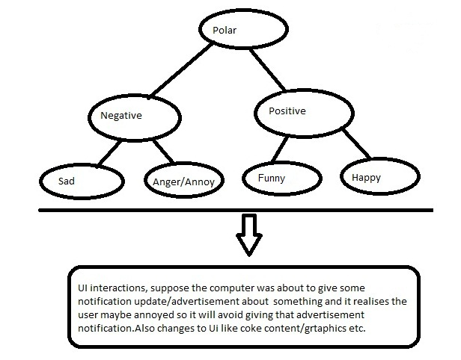
Approaches in our Implementation-This Semester
Binary approach to determine moods.
First to check if it is Positive or Negative.
If Positive check if it is Happy or Funny
If Negative check if it is Sad or Angry

Slide 7
Resources
Software's:-Python, NLTK, NumPy, SciPy,HTML,Javascript/Active X to keep it simple
Corpra:
For happy,funny,sad and angry we collected a 100 feature dataset of tweets and facebook status updates to test our demo.Due to the restriction of time we weren't able to collect them in a substantial amount however any future work will focus on increasing this size.
Positive corpra=funny+happy corpra
Negative corpra=sad+angry corpra

Slide 8
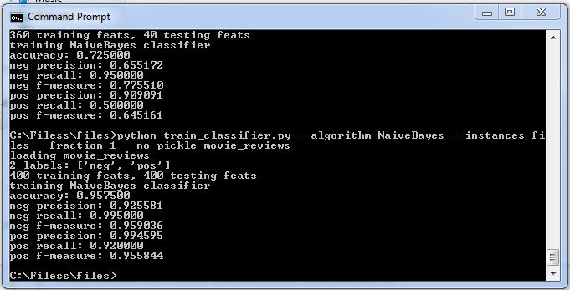
Training classifiers on the data
Bayesian Classifier,Bag of words featureset

Slide 9
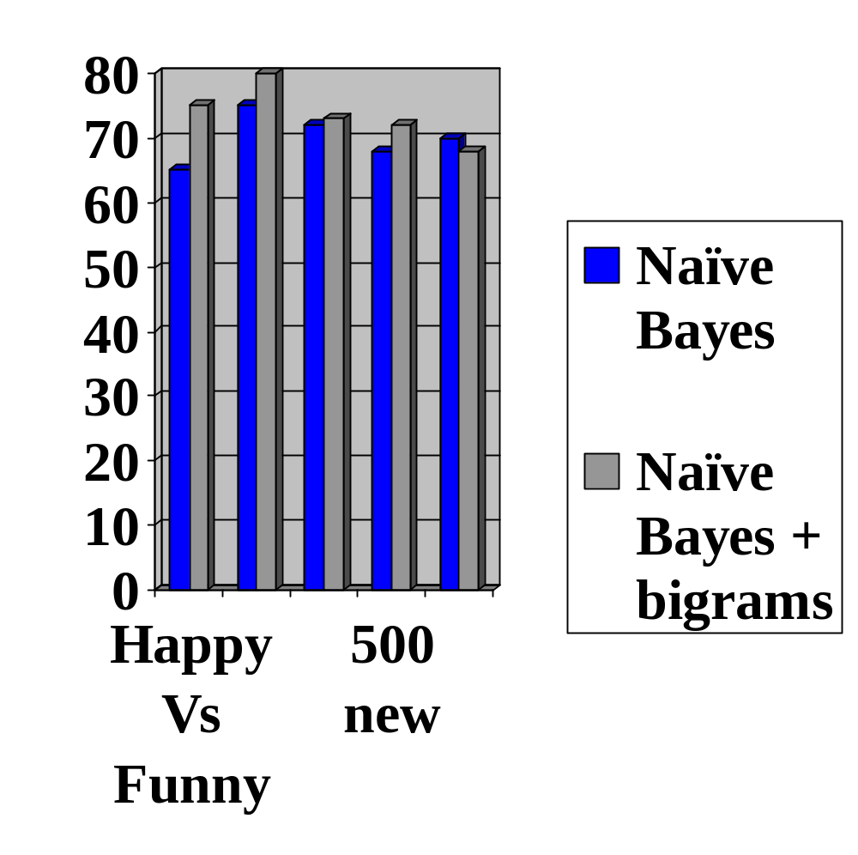
Results
With fraction 0.9 setting bigrams
Happy Vs Funny (200sets)-75%
Sad Vs Angry(200sets)-80%
Positive Vs Negative(400sets)-73%
Positive Vs Negative+movie reviews(400+100set)-72%
Movie reviews(500sets)-68%

Slide 10
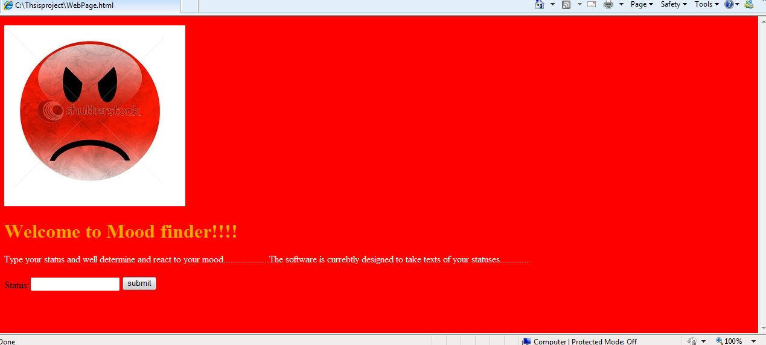
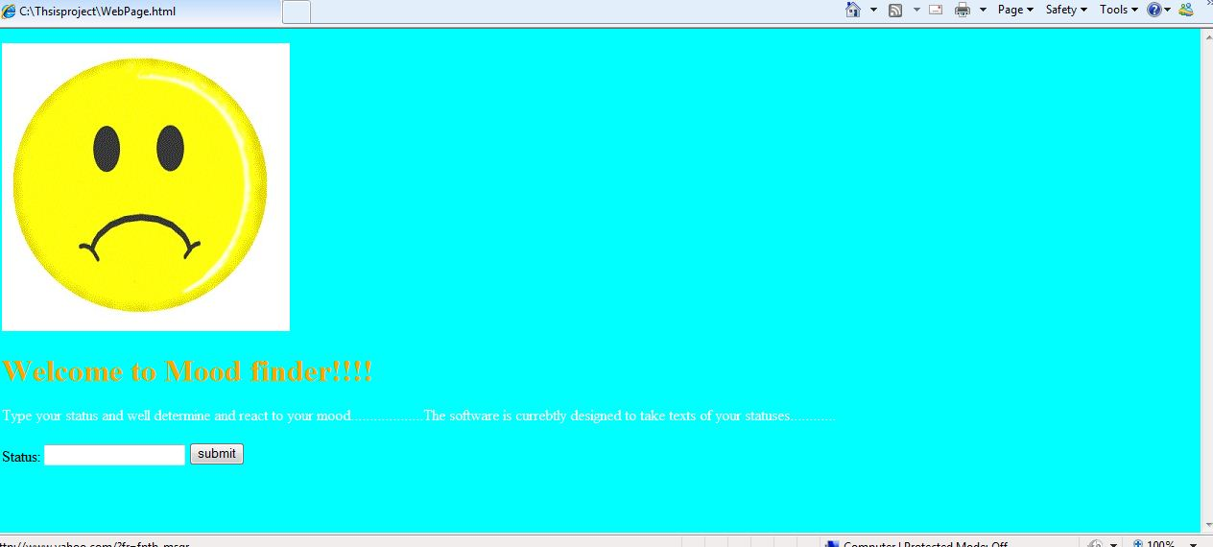
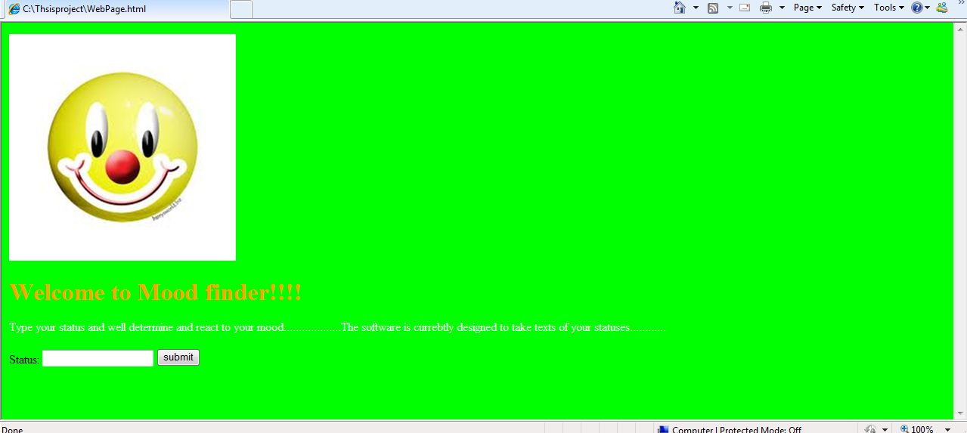
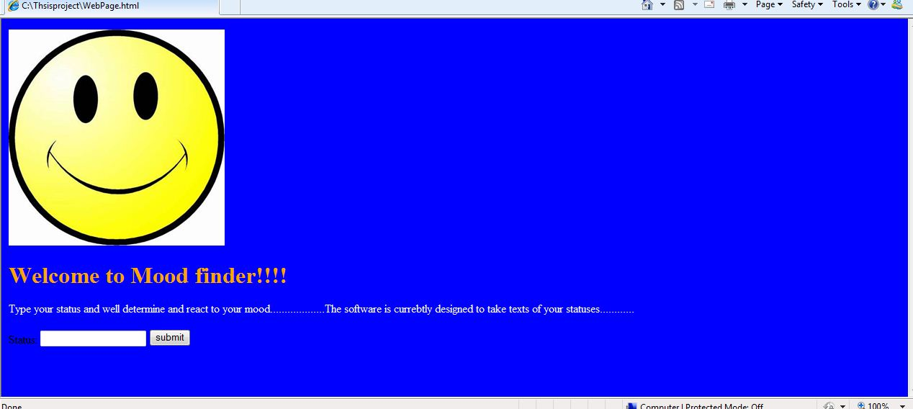
Implementations

Slide 11
Future Plans
To increase corpus data size.
Try other algorithms.
Work on ambiguity.

Slide 12
Question’s?
Thank you for listening and specially to those who have helped
☺☺☺
Fin

